Slide 1

Price i$ Right
Airbnb - Listings
Subhash Jaldu

Slide 2

Motivation
Help the new host to list his property at FAIR price
Help new hosts to improve occupancy rate by FAIR pricing
Need a model to predict the price of the UNIQUE listing
Features
Specalities
Surge
Seasonality

Slide 3

Dataset
S.No. | Data | Size | Age | Data Size
1 | Calendar | 1.8mil x 4 |  | 8 million
2 | Listings | 5000 x 96 |  | ~ 500K
3 | Neighborhood | 37 x 2
4 | Reviews | 250K x 6 | 9 years | 1.5 mil
5 | Geolocation |  |  | SF, Bayarea, LA County
Rich Data with 96 features 5k listings = 500K data points/county

Slide 4
Flow
Raw Data Acquisition
Feature Engineering
Price
Split
Time Series Split
Linear
Regression
Random
Forest
Gradient
Boost
Gradient
Boost
Random
Forest
Linear
Regression
Hyper Parameter Tuning

Slide 5



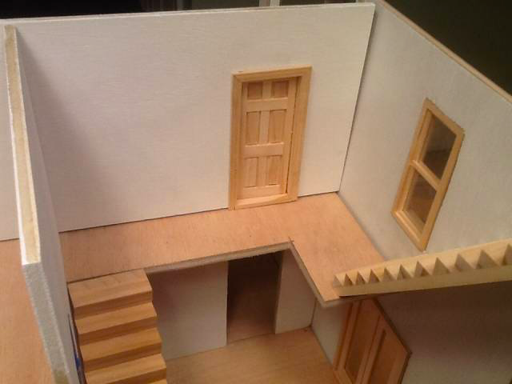













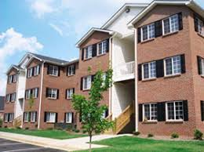


Feature Analysis
Data Cleanup
Transform data
Missing values
Categorical
Relational Features
Category Condensation
Imputed sparse data sets
Luxury
Special Types

Slide 6
Feature Analysis
Bathroom
Shared
Private
Bed Type
Cozy
Comfy
Bunk
Sofabed
Data Cleanup
Transform data
Missing values
Categorical
Relational Features
Category Condensation
Imputed sparse data sets
Luxury
Special Types
Property Type
Single Family
Apartments
Cabins
Treehome
Hotel
Hostel
Public Transport
Nearby
Far
Entrance
Shared
Private
Amenities
Few
Some
Plenty
Cleaning Charges
High
Low
Zero
Bedrooms
Shared
Private

Slide 7
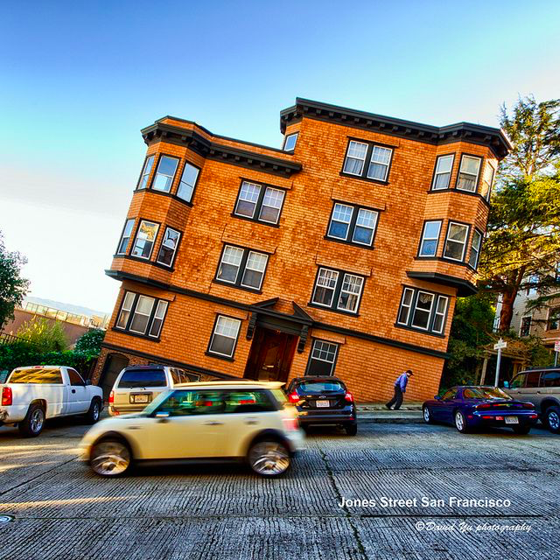
Model Ensemble
Models :
Linear Regression
Random Forest
Gradient Boost
Data :
Common Listings
Time Series Split

Slide 8

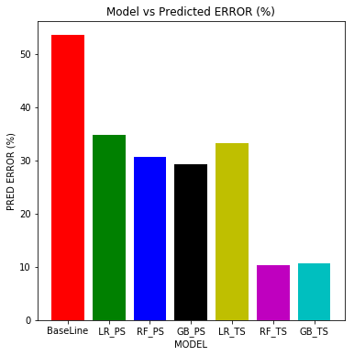
Result Analysis
Metric |  | Linear Regression | Random Forest | Gradient Boost | Linear Regression | Random Forest | Gradient Boost
 |  | Random Split |  |  | Time Series Split
R² |  | 0.56 | 0.64 | 0.62 | 0.54 | 0.88 | 0.88
MSE |  | 4155 | 3366 | 3578 | 4618 | 1187 | 1190
RMSE |  | 64.46 | 58.02 | 59.82 | 67.96 | 34.46 | 34.50
RMSLE |  | 0.38 | 0.33 | 0.33 | 0.37 | 0.19 | 0.20
PCT Error (MAPE) |  | 34.86% | 30.62% | 29.20% | 33.27% | 10.37% | 10.71%
Baseline Error |  | $77.42 | $77.42 | $77.42 | $79.72 | $79.72 | $79.72
Predicted Error |  | $49.56 | $43.98 | $43.46 | $50.37 | $15.44 | $15.90
Best FIT
Baseline

Slide 9
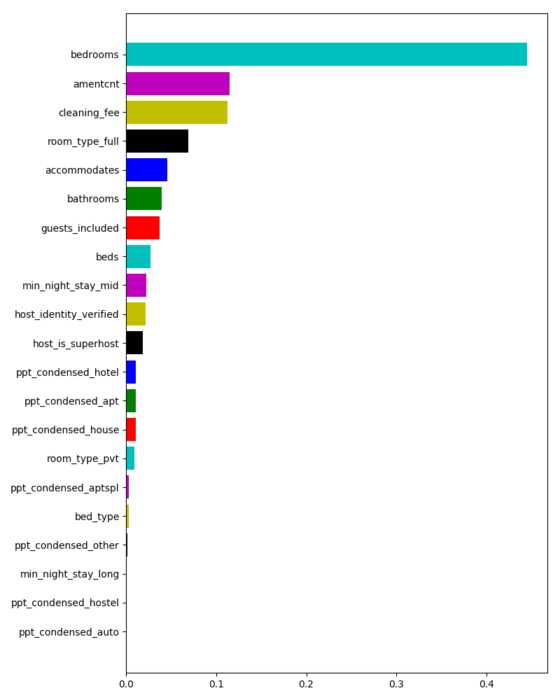
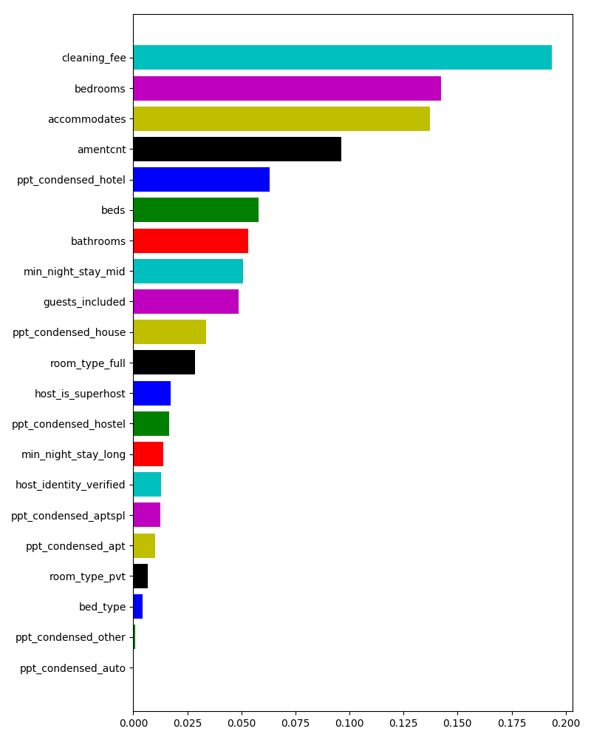
Feature Importance (RF vs GB)

Slide 10
Result Analysis
Prediction Metrics
R² : 0.8817
PCT ERROR : 10%
Baseline ERROR : $ 79.00
Predicted ERROR : $ 15.90
Ensemble :
Random Forest and Gradient Boost
Time Series

Slide 11
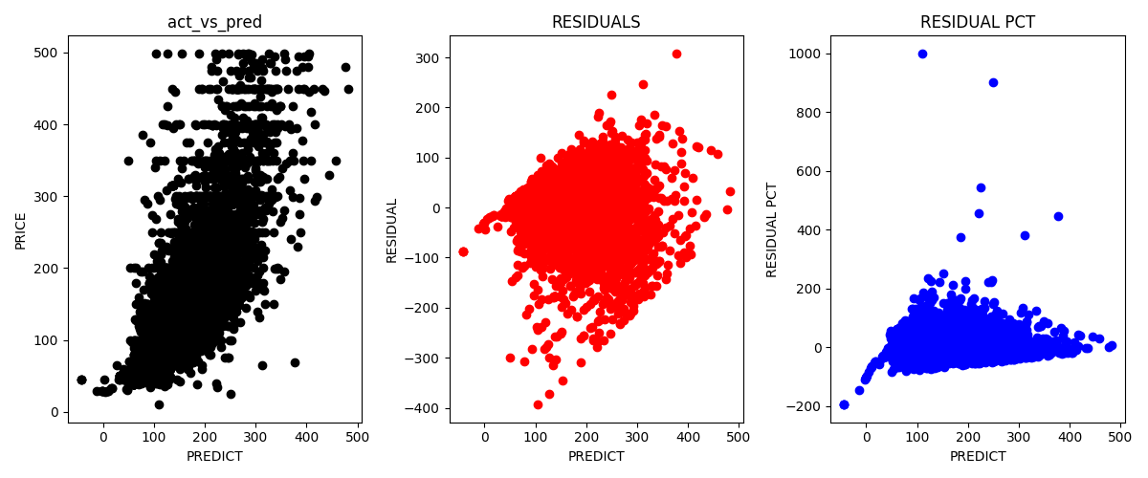
Model Metrics : Linear Regression

Slide 12
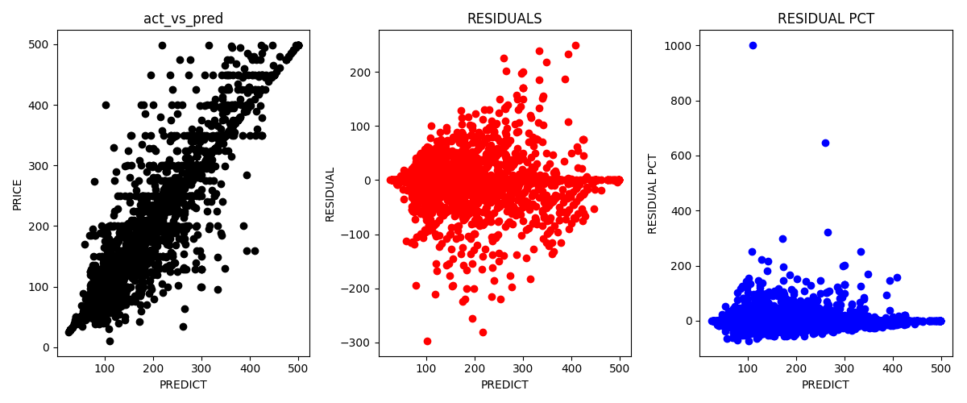
Model Metrics : Random Forest

Slide 13
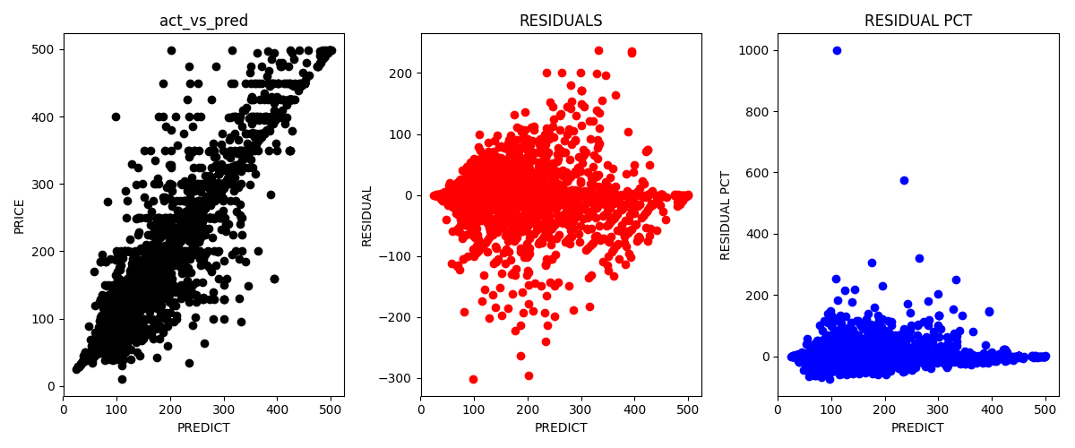
Model Metrics : Gradient Boost

Slide 14
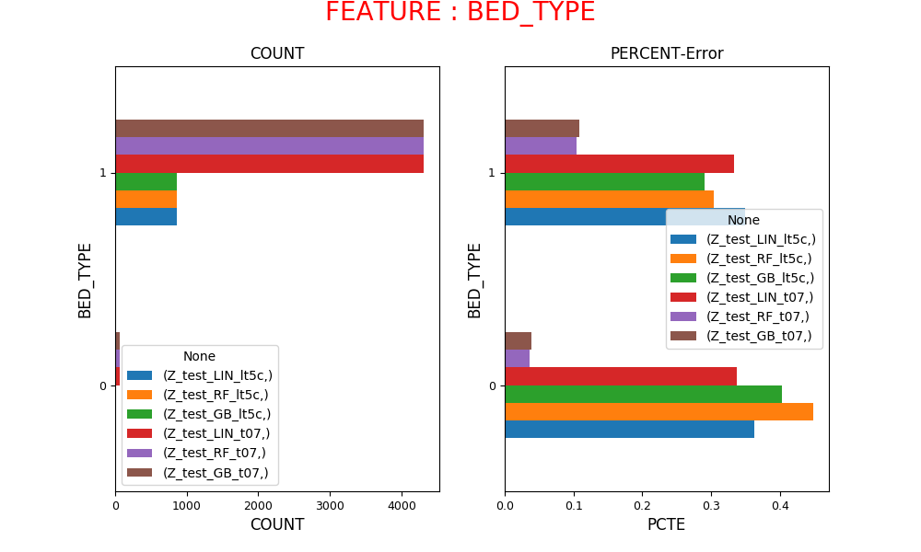
Model Performance Vs Bedtype

Slide 15
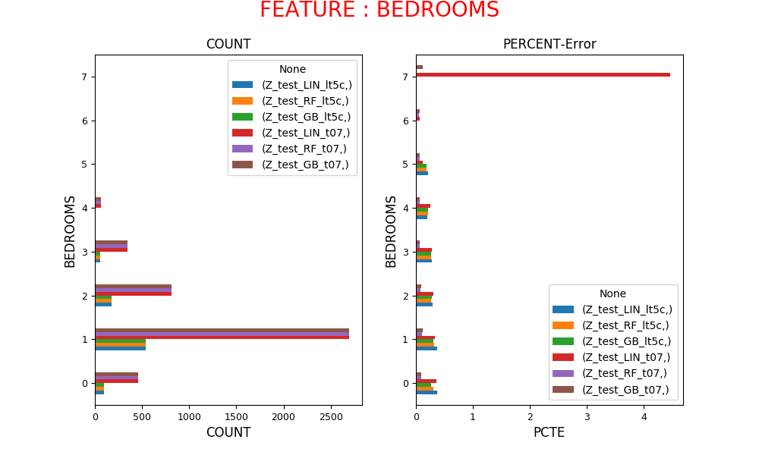
Model Performance Vs Bedrooms

Slide 16
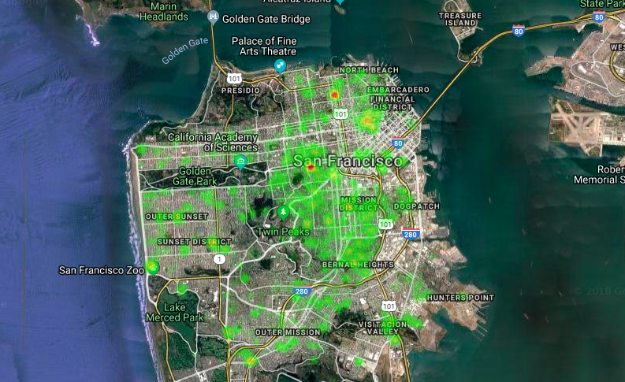
Model Performance Vs Location

Slide 17
Future Improvements
Add complete time series to include seasonal signal
Analyze real time demand predict a surge for Host
Analyze the reviews to provide a feature sentiment analysis to Host
Update the model to support special cases

Slide 18
Thank you
Questions?
Github : https://github.com/sgjcyp/capstone_price_is_right

Slide 19
Motivation
Airbnb is a portal for homeowners to host the Property
Typically Hosts review the current listings to decide the price
Need a model to predict the price of the listing
Features
Uniqueness
Surge
Seasonality

Slide 20
Process
Data Engineering
Modelling
Model & Hyper Parameter Tuning
Result Analysis
Feature Analysis
Regression Models
Measure Performance
Results vs Model
Identify Prime Features
Create Relational Features
Linear Regression
Random Forest
Gradient Boost
Same Metrics to measure multiple models and datasets
Model Performance in Various Categories

Slide 21
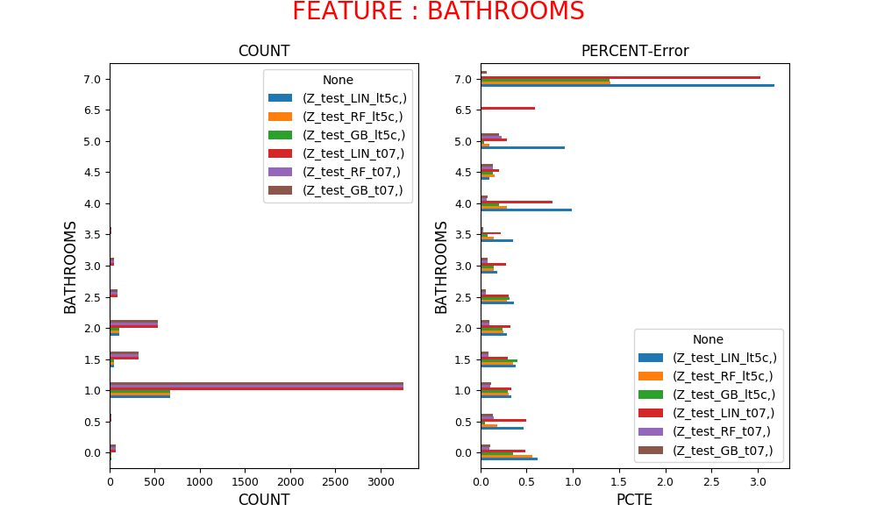
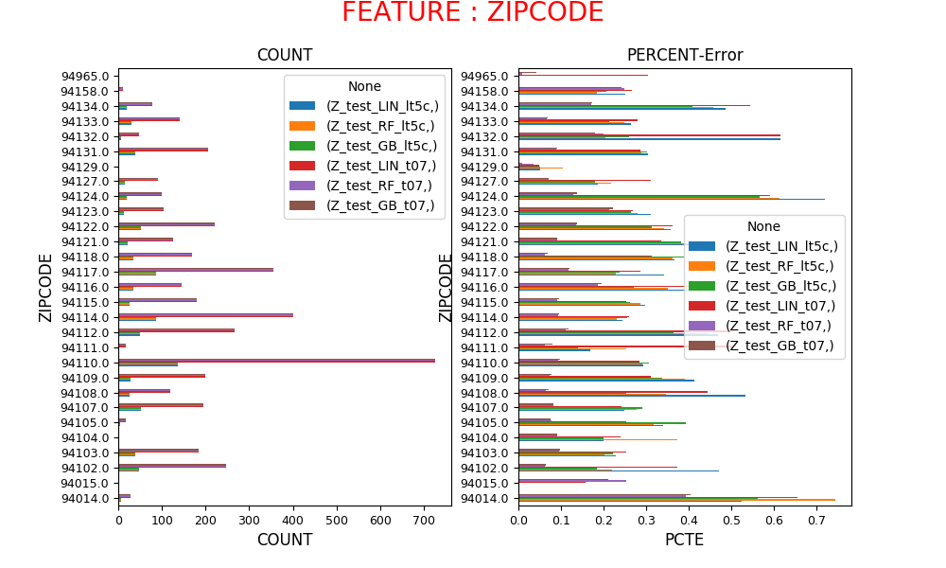
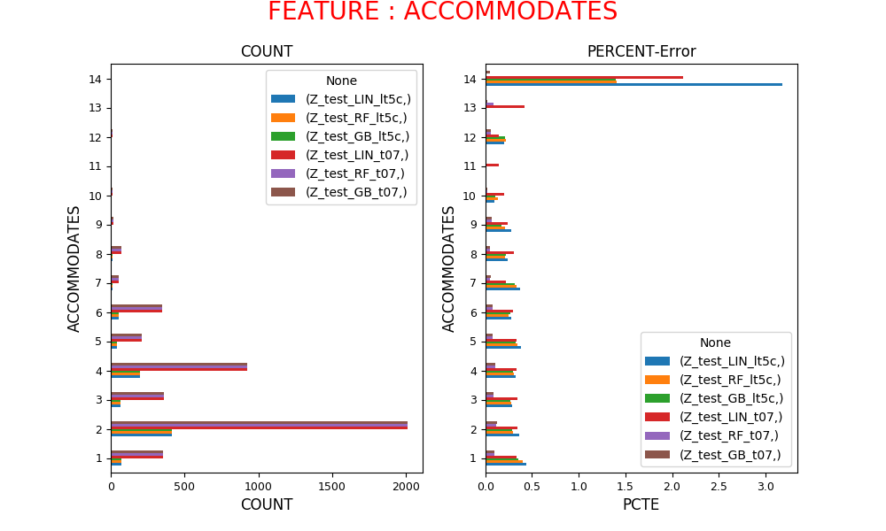
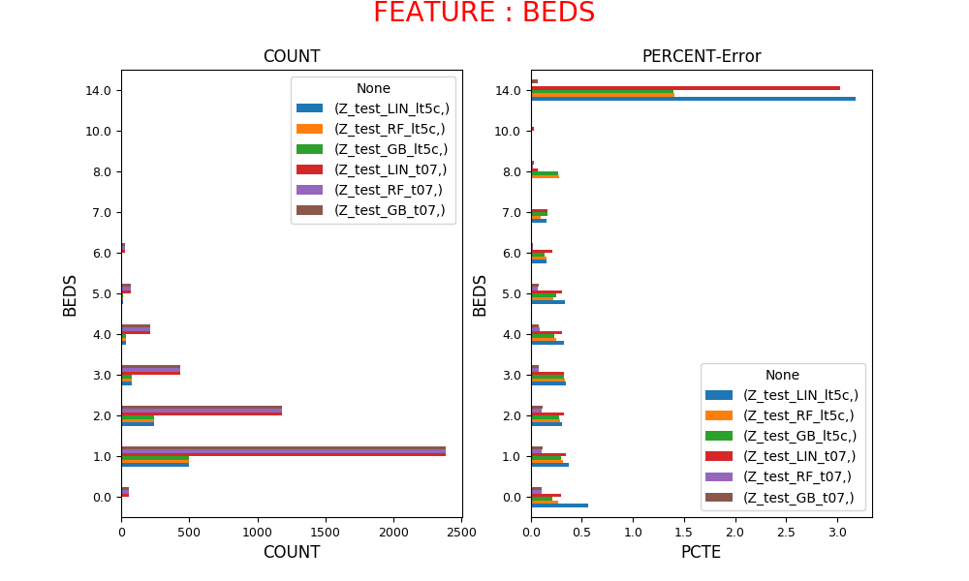
Model Performance Vs Features

Slide 22
Model Performance Vs Bathrooms

Slide 23
Model Performance Vs Accommodates

Slide 24
Model Performance Vs Beds

Slide 25
Model Performance Vs Zipcode

